Slide 1

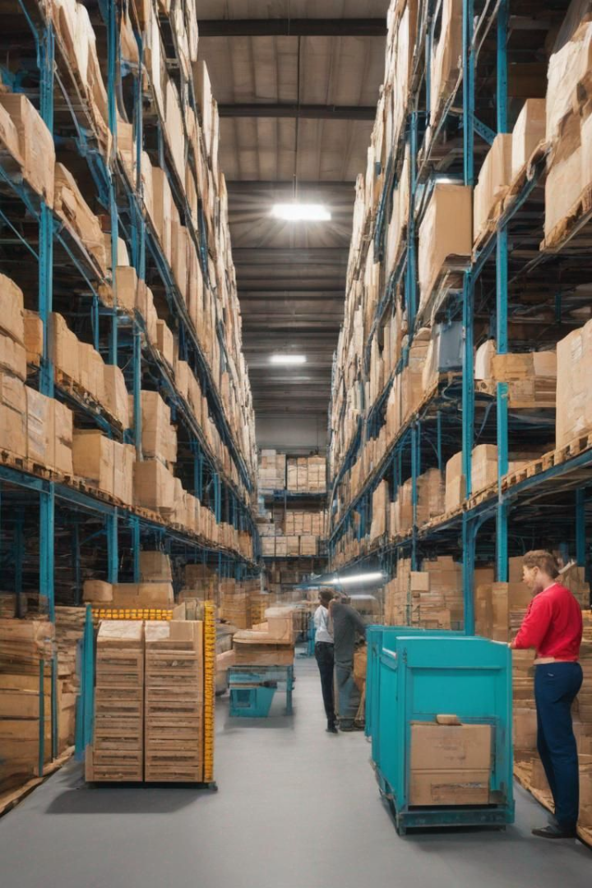
Annapurna India - Revolutionizing Food Distribution
Welcome to the Annapurna India presentation, where we introduce a cutting-edge platform designed to combat food wastage and contribute to the global effort to reduce hunger.

Slide 2

The Global Food Paradox
1
Food Wastage Statistics
2
Impact on Hunger
Every year, millions of tons of food go to waste globally.
Food wastage worsens world hunger by squandering resources that could address nutritional needs, increasing demand for agricultural production, leading to resource depletion, and creating ethical concerns as people go hungry while edible food is discarded. Addressing food wastage is vital to conserve resources, reduce environmental impact, and redirect food towards those in need.
According to the latest statistics from 2023, the amount of food wasted continues to be a significant issue.

Slide 3

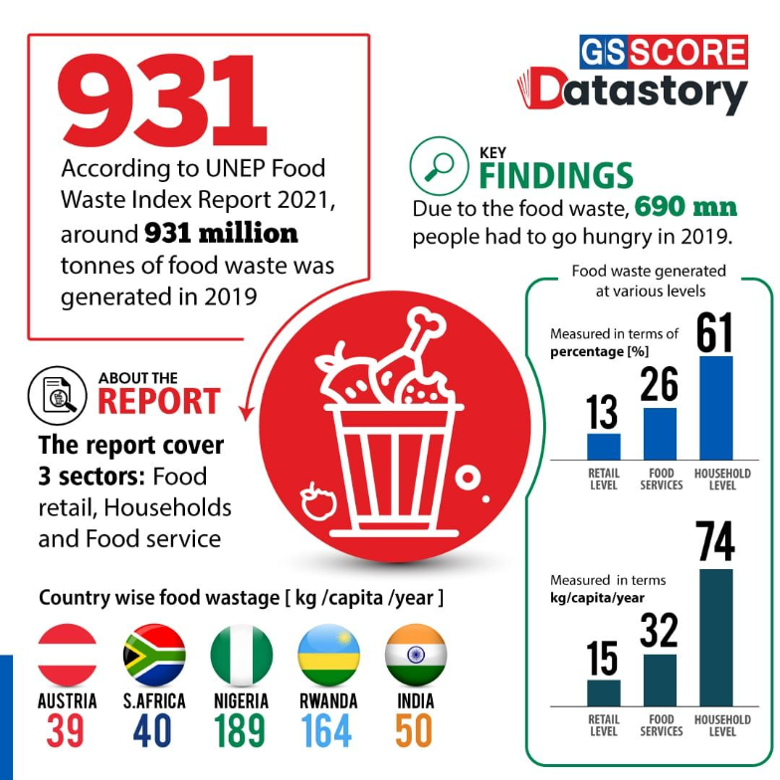

Slide 4

Vision and Mission of Annapurna India
Vision Statement
Mission
Annapurna India aims to create a world where surplus food meets the needs of the hungry.
To build a platform connecting food providers and NGOs for efficient food distribution.

Slide 5

User-Friendly Interface
Simple Navigation
The simplicity of web and app interfaces has revolutionized the way users connect with NGOs and other concerned authorities responsible for food distribution. These user-friendly platforms serve as powerful bridges, seamlessly linking individuals with a willingness to contribute to those in need. The straightforward design and intuitive features of these applications make it easy for users to locate nearby NGOs, understand ongoing initiatives, and actively participate in food distribution programs. The streamlined communication channels enable swift coordination between users and authorities, fostering a collaborative and efficient approach to address food insecurity. Through the simplicity of these digital platforms, the process of connecting those with resources to those in need has become not only more accessible but also more immediate, ensuring a timely response to the pressing issue of hunger in communities.

Slide 6
Bridging the Gap
Connecting Providers
Efficient Distribution
Showcasing how the platform seamlessly links surplus food providers like hostels, restaurants, functions, etc. to nearby NGOs, making it easy for them to communicate and help in efficient food distribution.
Highlighting the efficiency of this connection, ensuring timely and effective distribution of surplus food to those in need.

Slide 7



Annapurna India's Ripple Effect
Social Responsibility
Community Engagement
The platform plays a crucial role in reducing food wastage and takes a step forward in addressing the world hunger problem. By connecting surplus food providers with nearby NGOs, Annapurna India actively works towards minimizing food wastage and ensuring that nutritious meals reach those in need.
Annapurna India provides an opportunity to those who want to make a difference and help the cause. Encourage active community participation in the fight against hunger.

Slide 8

Be a Changemaker with Annapurna India
Inviting NGO's to Collaborate
Opportunities for Collaboration
Join us in our mission to fight hunger and malnutrition by collaborating with Annapurna India.
Explore the various ways you can contribute to the cause, from volunteering to fundraising.
Together, we can make a real difference in the lives of those who need it most.
Together, we can build a better future for India and its people.

Slide 9

Your Support Matters
1
Gratitude
2
Collective Impact
Thank you for your time and attention. We appreciate your support.
Annapurna India has the potential to make a significant collective impact on global food wastage and hunger. Together, we can create a world where everyone has access to nutritious food.

